Slide 1
Supporting tools for the new masters’ curriculum
Emil Doychev
e.doychev@isy-dc.com
Veselina Valkanova
veselina_viva@abv.bg
University of Plovdiv, Bulgaria

Slide 2
What is DeLC?
A web portal implemented by using the Liferay open source portal system (pure Java technology).
Developed mainly to support the masters’ program “Software technologies” in the Faculty of mathematics and informatics in the University of Plovdiv.
Used in bachelor education, too.
In production mode for more than two years, already.
Access is not public - restricted to students and staff.
Currently it has 729 registered users (from which 591 active).

Slide 3
Used tools
Provided by Liferay framework:
Dynamic Data Lists (DDL)
Documents and media library
Communication facilities:
Offline – message boards and page comments
Online – instant messaging (chat)
Developed by us:
Electronic tests
SCORM Player (in progress)
Event management
Student grade book
Third-party tools:
Redmine (project management tool)

Slide 4
[Liferay] Dynamic Data List
Collecting simple input from the user / developing entire entry system for real estate listings.
Provide an easy way to create, aggregate and display new data types.
Data Lists are flexible enough to handle all types of data.
Main activities are divided in two concepts:
Data defining:
Define your own data definitions
Create new lists from those definitions
Customize the input forms for ease of use
Data displaying:
Customize the output format
Integrate lists into Workflow
Combined with the flexibility provided through templates, the power of languages like Velocity and workflow management, entire applications can be built in a short time.

Slide 5
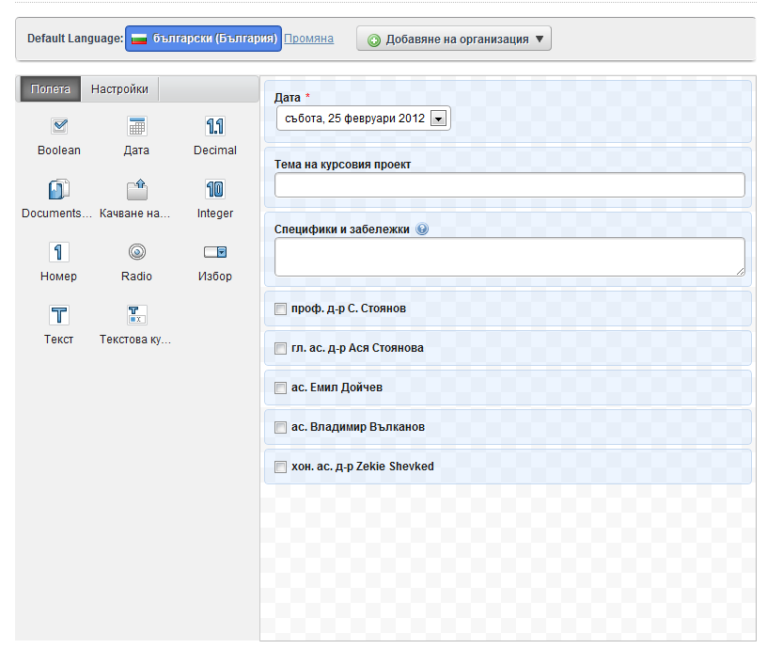
[Liferay] Dynamic Data List
Create a data definition by using a visual builder

Slide 6
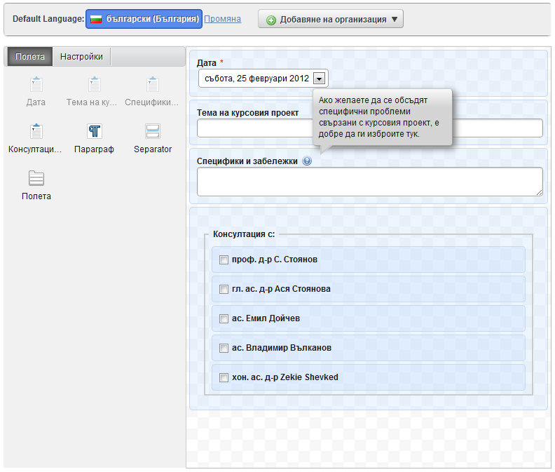
[Liferay] Dynamic Data List
Customizing the input form for the data definition.

Slide 7
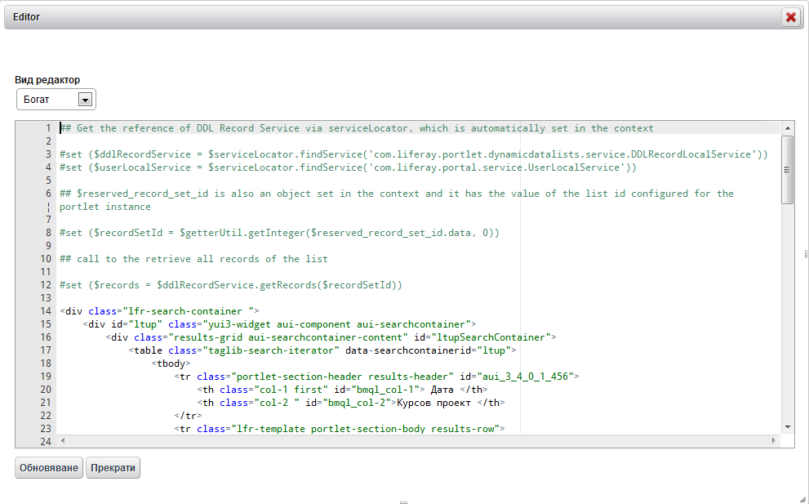
[Liferay] Dynamic Data List
Customize the list display by using Velocity or XSLT.

Slide 8
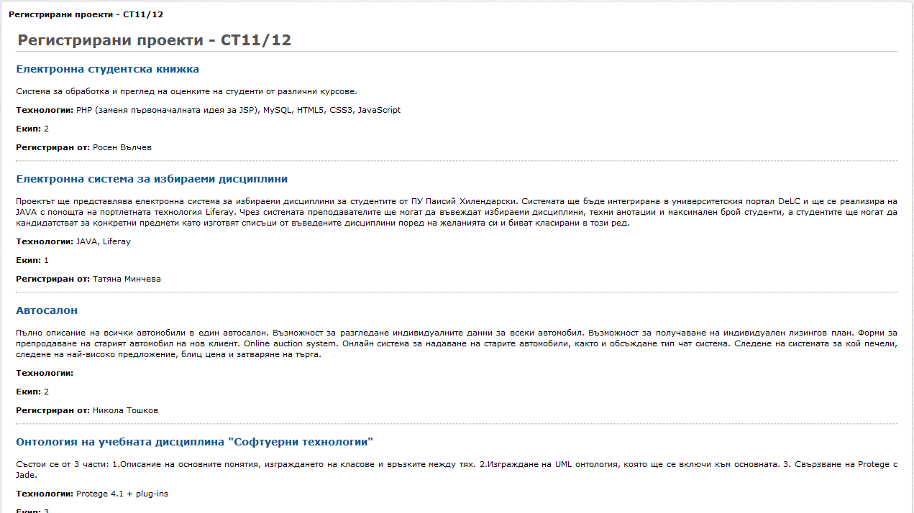
[Liferay] Dynamic Data List
Custom view of a data list

Slide 9
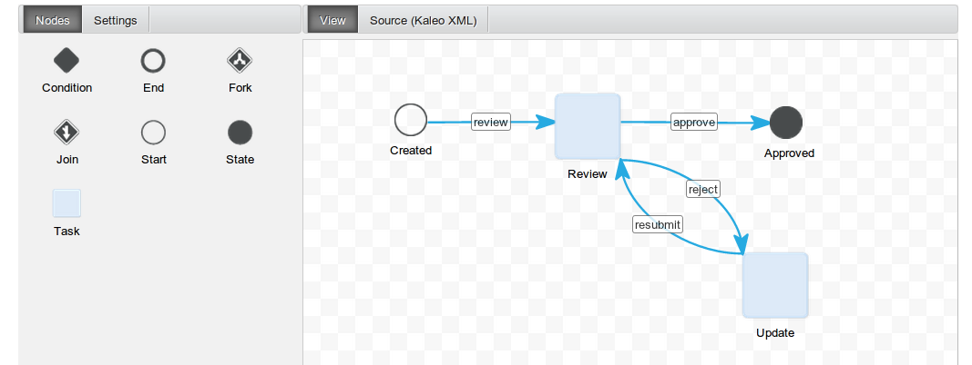
[Liferay] Dynamic Data List
After building custom form backed by a data list is done, a custom workflow can be deployed to the form and its data.

Slide 10
[Liferay] Dynamic Data List
How we use it?
Mostly for registration forms for:
Course projects and diploma thesis
Course projects and diploma thesis consultations
Elective specialization

Slide 11
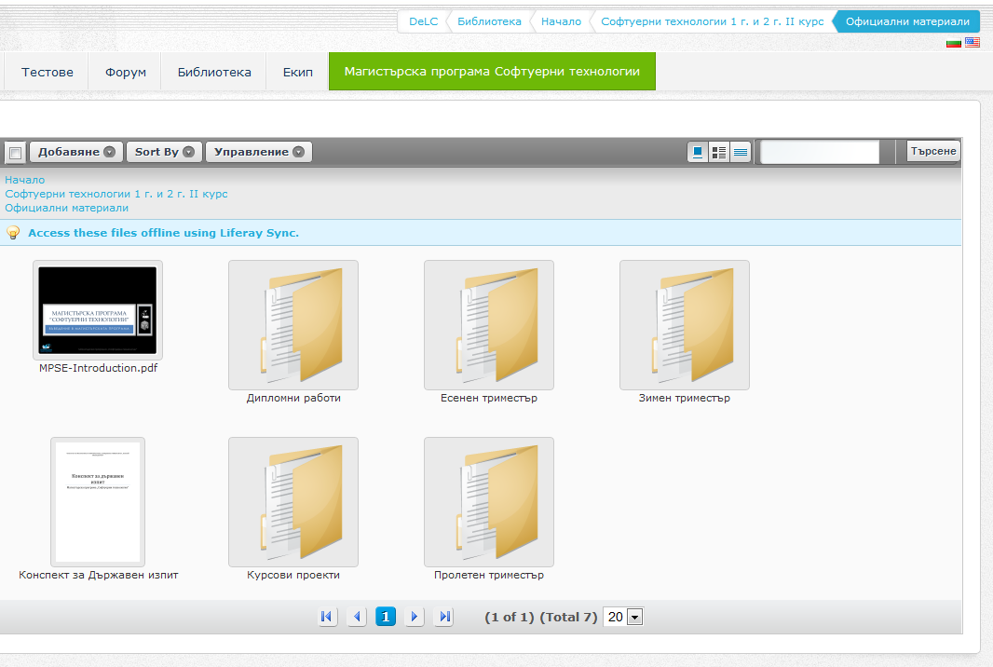
[Liferay] Documents and media library
Documents and Media library provides a mechanism for storing files online using the same type of structure that is used to store files locally.
Any kind of files are supported.
It serves as a virtual shared drive.
Rich security policies based on roles, groups and individual users

Slide 12
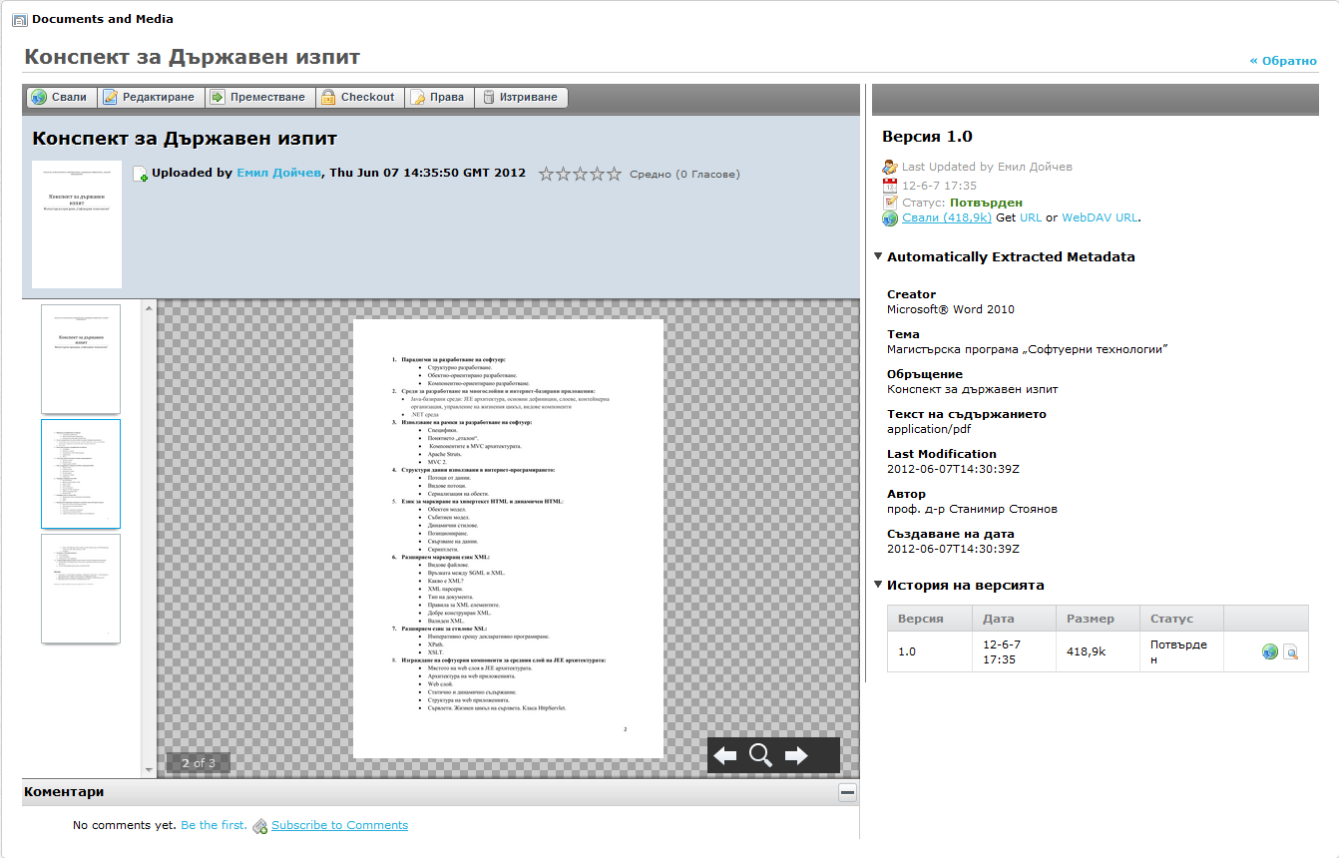
[Liferay] Documents and media library
Customizable document types and metadata sets, automatic document preview generation.
Allows to connect to multiple third-party repositories that support CMIS 1.0 with AtomPUB and Web Services protocols.

Slide 13
[Liferay] Documents and media library
How we use it?
Storing of static content
Lectures in PDF format
Archives in ZIP/RAR format with source code

Slide 14
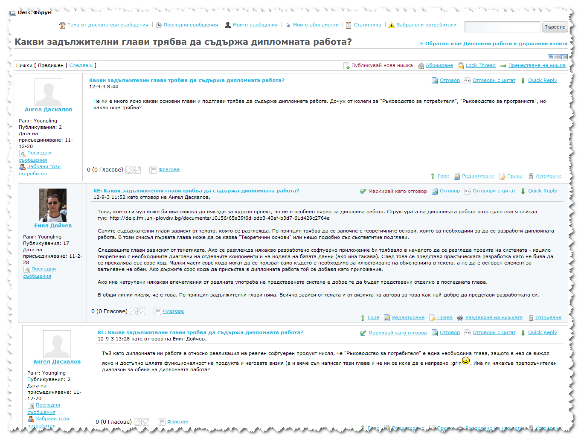
[Liferay] Message boards
Message Boards portlet is a state of the art forum application.
Liferay’s message boards provide an integrated experience – no separate registration is needed.

Slide 15
[Liferay] Message boards
How we use it?
Offline communication with the students
No anonymous postings
Highly moderated – only topics that worth

Slide 16
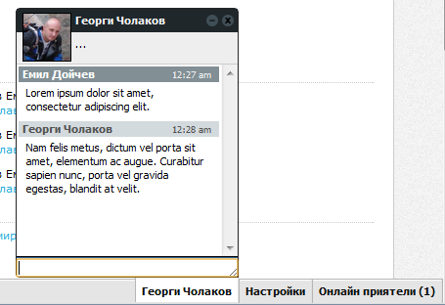
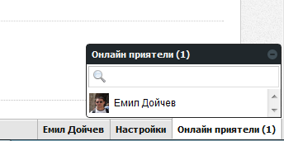
[Liferay] Instant messaging
Provides a convenient way of allowing users to send each other instant messages when they are logged into portal.
It appears as a bar at the bottom of every page, showing who is logged on, their statuses, and any chats the logged-in user has open.

Slide 17
[Liferay] Instant messaging
How we use it?
Available to all users
Unmoderated instant messaging
Monitored by a software agent (fraud detector) during exams with the test system

Slide 18
[Own] e-Tests
Presented in separate talk by Vladimir Valkanov
Currently new version is developing (QTI 2.1)

Slide 19
[Own] SCORM Player
Supported specification: SCORM 2004 R4
Development is still in progress
Player and management portlets are ready
Sequencing and navigation module is ready approx. on 70%
Used technologies and frameworks: Grails, Groovy, ExtJS
Goal: to pass the ADL’s conformance and compliance tests.

Slide 20
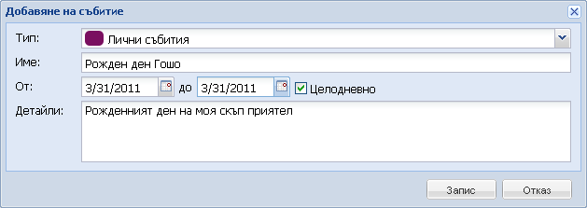
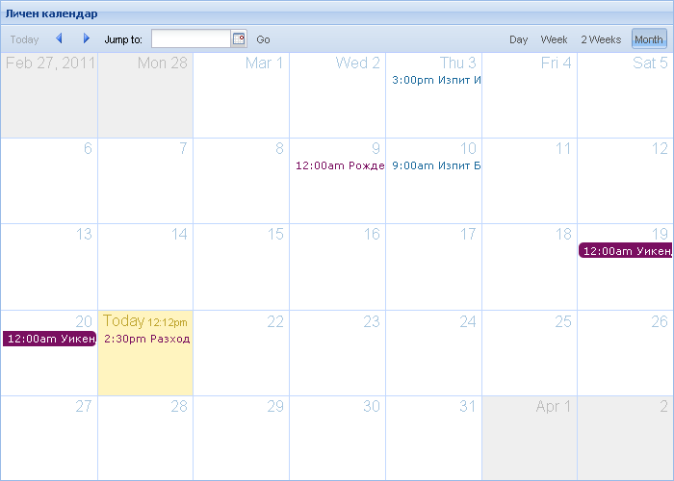
[Own] Event management
Allows event publishing, reviewing and subscription for notifications.
Custom event types:
Lecture
Practice
Exam
Consultation
…
Strong security policy

Slide 21
[Own] Grade book
Considering reconstruction to conform to Common Cartridge model.
Integrated with e-Test and SCORM Engine by the Liferay’s message bus.

Slide 22
[Third-party] Project management
Redmine is a flexible project management web application.
Written using the Ruby on Rails framework, it is cross-platform and cross-database.
Redmine is open source and released under the terms of the GNU General Public License v2 (GPL).

Slide 23
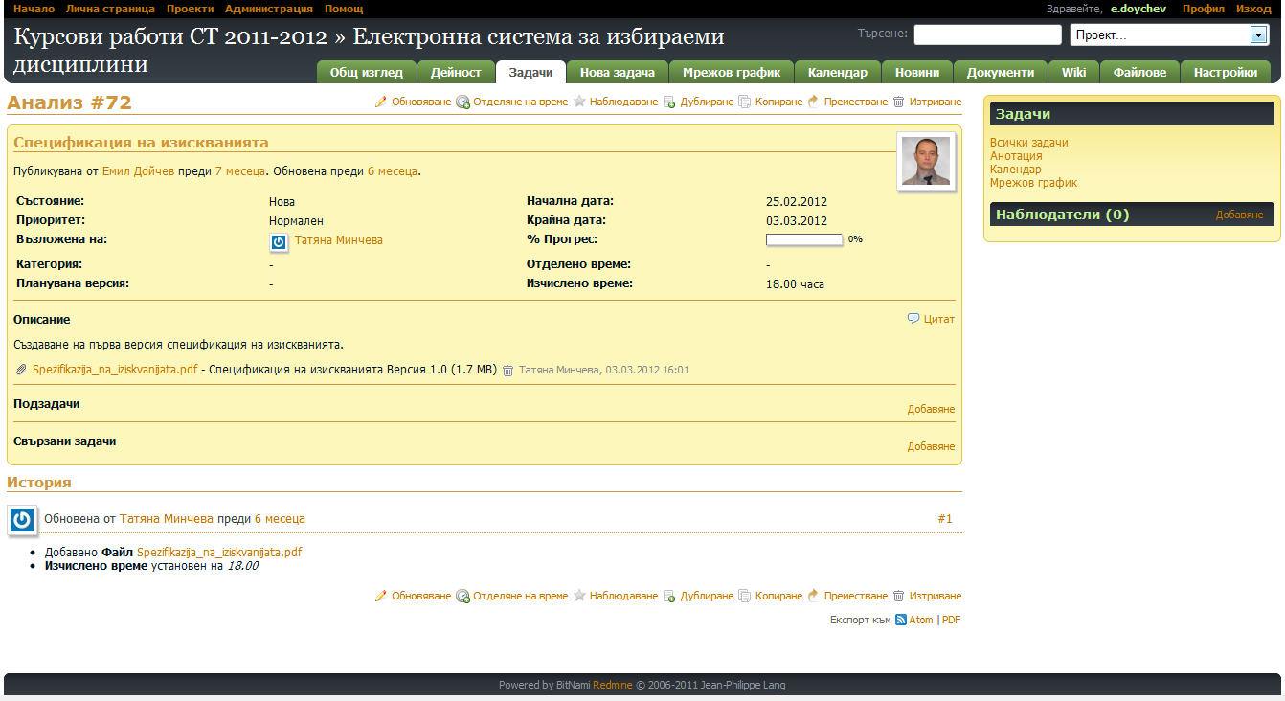
[Third-party] Project management
Multiple projects support
Flexible role based access control
Flexible issue tracking system
Gantt chart and calendar
News, documents & files management
Feeds & email notifications
Per project wiki
Per project forums
Time tracking
Custom fields for issues, time-entries, projects and users
SCM integration (SVN, CVS, Git, Mercurial, Bazaar and Darcs)
Issue creation via email
Multiple LDAP authentication support
Multilanguage support

